Slide 1


Adversary Emulation Framework
Mentors: Dr. Alcides Alvear Suarez & Robel Campbell
Integrants: Kiara Rivera Domenech, Genesis Resto, Carlos Roque
Date: February 28th, 2023

Slide 2
Table of Contents
Problem Definition
Solutions
Command and Control Framework
Solution Diagram
Machine Learning Malware Detection
Solution Diagram
Project Scope
Tools
Reasoning
Functional Requirements
Non-functional Requirements
Database
Structured Diagram
Use Case UML
References
Q&A
G. Resto, K. Domenech, C. Roque Adversary Emulation Framework
1

Slide 3

Problem Definition
In the current state of anti-malware systems, defenders focus on a broad understanding of modern malware evasion techniques that their systems have the capability to detect, but the knowledge gap between malicious actors and security engineers makes these systems look frail.
G. Resto, K. Domenech, C. Roque Adversary Emulation Framework
2

Slide 4

Solutions
G. Resto, K. Domenech, C. Roque Adversary Emulation Framework
3

Slide 5
Command and Control Framework
Dynamic Evasion – Variable Syscalls, ETW/AMSI Patching
In-memory Execution – Download Cradles, Microcontroller
Encrypted Payloads – AES-256, XOR
G. Resto, K. Domenech, C. Roque Adversary Emulation Framework
4

Slide 6
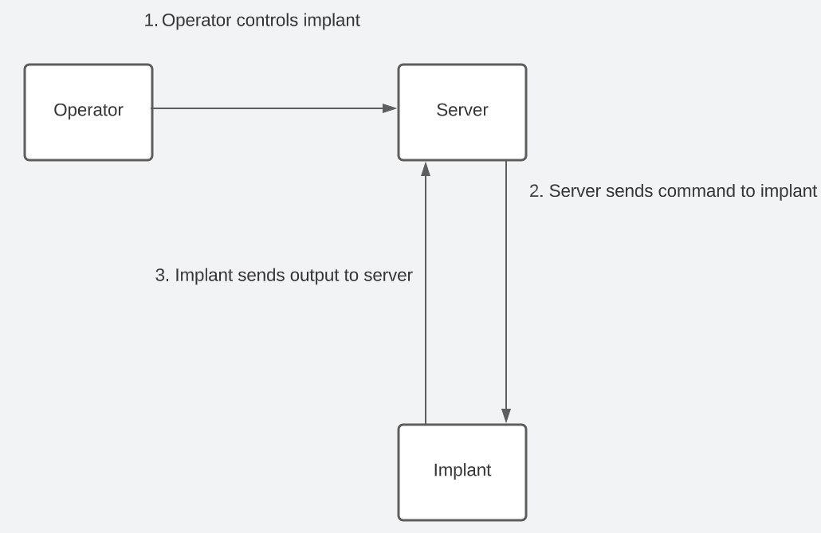
Solution Diagram
G. Resto, K. Domenech, C. Roque Adversary Emulation Framework
5

Slide 7
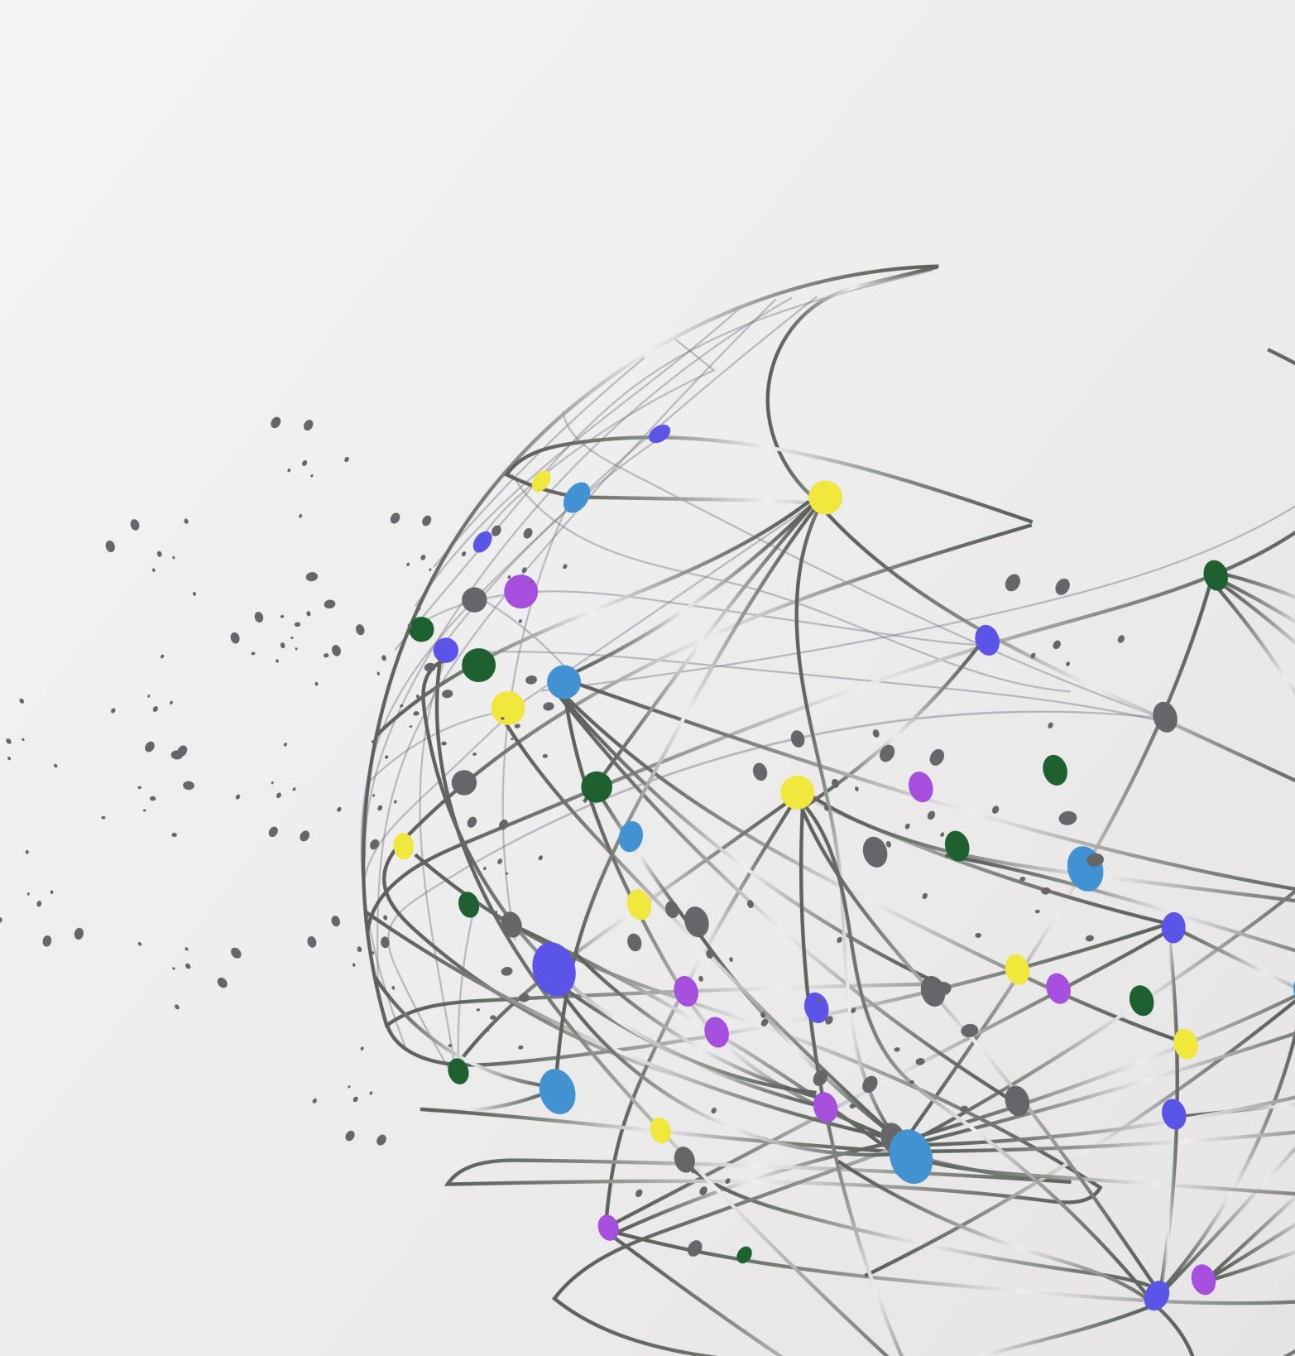
Machine Learning Malware Detection
Detect:
High Entropy – Code Obfuscation
Region Manipulation – Memory Region Permissions
Code Injection – Process Hollowing, Classic Loading/Injecting
G. Resto, K. Domenech, C. Roque Adversary Emulation Framework
6

Slide 8
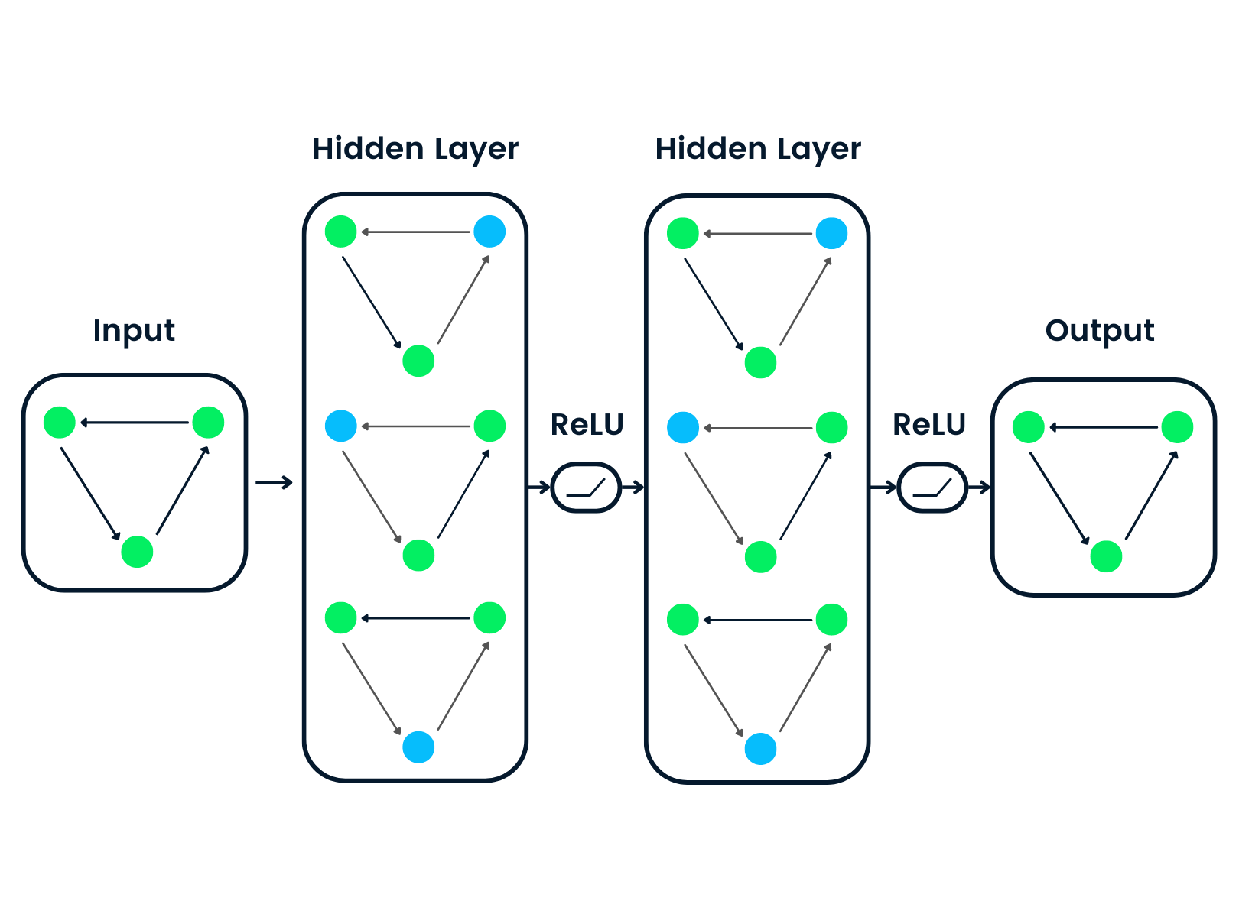

Solution Diagram
Hidden Layers
Hidden Layers
Output:
Benign
Malicious
Process Raw Bytes
https://www.datacamp.com/tutorial/comprehensive-introduction-graph-neural-networks-gnns-tutorial
G. Resto, K. Domenech, C. Roque Adversary Emulation Framework
7

Slide 9
Project Scope
Outline weak defense mechanisms
Provide operators with modern evasion techniques
Attack visualization with gathered information
G. Resto, K. Domenech, C. Roque Adversary Emulation Framework
8

Slide 10
Tools
Server and Client applications
Windows Forms .NET Framework (GUI)
Virtual Private Server
Docker Machine
Arduino
G. Resto, K. Domenech, C. Roque Adversary Emulation Framework
9

Slide 11

Reasoning
Command and Control
Cloud
Arduino
.NET Framework
Microservices
Containers
G. Resto, K. Domenech, C. Roque Adversary Emulation Framework
10

Slide 12
Functional Requirements
Implant:
Employ various evasion tactics to avoid detection.
Results of executed instructions received by the server must be sent back to the server.
Must have the ability to load new modules or code dynamically.
Survive reboots by implementing persistence.
Collect victim information for database
Server:
Send instructions to the implant and receive the output.
Provide implant templates for customization.
Store victim information in a database using secure methods.
Manage module handler to host modules for execution on the implant.
Provide secure and reliable communication channels.
Interface:
Provide operator ability to generate implants.
Dashboard to manage one or multiple implants.
Ensure secure authentication and authorization for operators.
Output the results from instructions executed on the implant.
Database:
Storing and managing data related to victims, and operators securely.
Provide search and filtering capabilities to quickly locate specific information.
Enforce consistency and validation to avoid errors and corruption.
G. Resto, K. Domenech, C. Roque Adversary Emulation Framework
11

Slide 13

Non-Functional Requirements
Operate with reduced latency or delay.
System should be extensible.
Functionality should be documented.
System should be robust in the ability to sustain errors and user input.
Ensure server availability for operators and implants.
Optimization techniques should be employed for performance.
Regulations should be enforced for best practices and safety standards.
Infrastructure needs to support scalability either vertically or horizontally.
Interface needs to be intuitive for the operator.
G. Resto, K. Domenech, C. Roque Adversary Emulation Framework
12

Slide 14
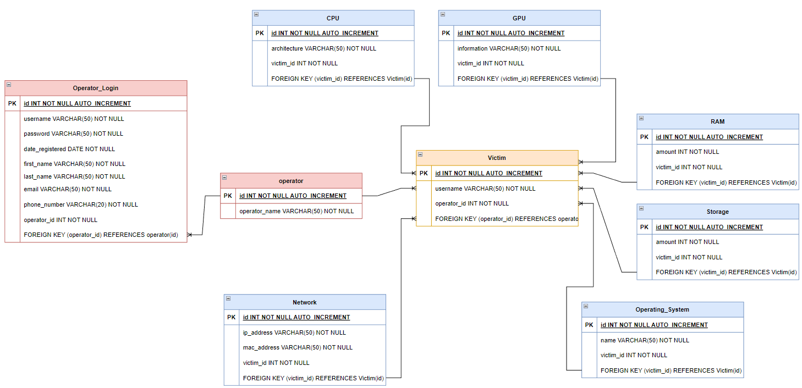
Database
G. Resto, K. Domenech, C. Roque Adversary Emulation Framework
13

Slide 15
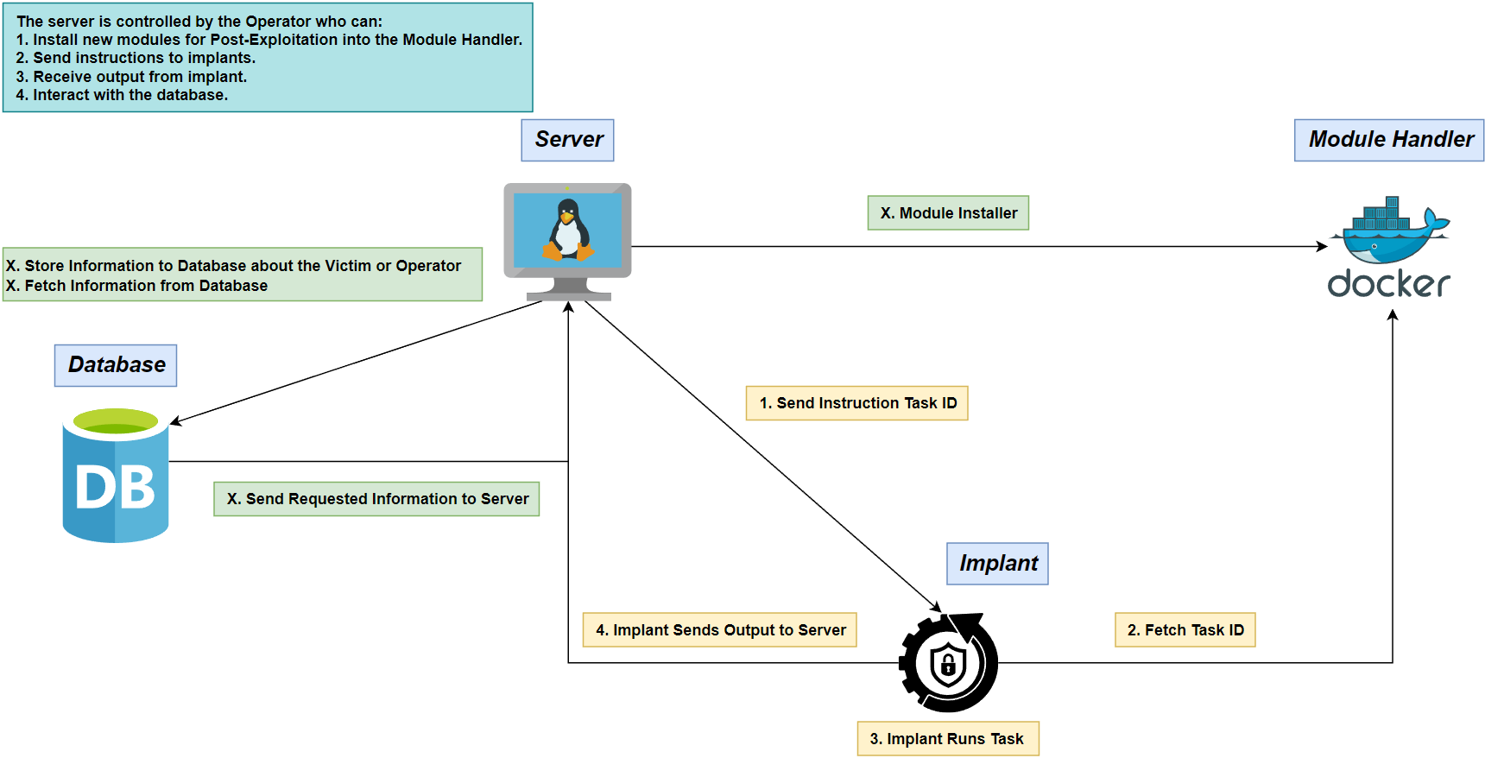
Structure Diagram
G. Resto, K. Domenech, C. Roque Adversary Emulation Framework
14

Slide 16
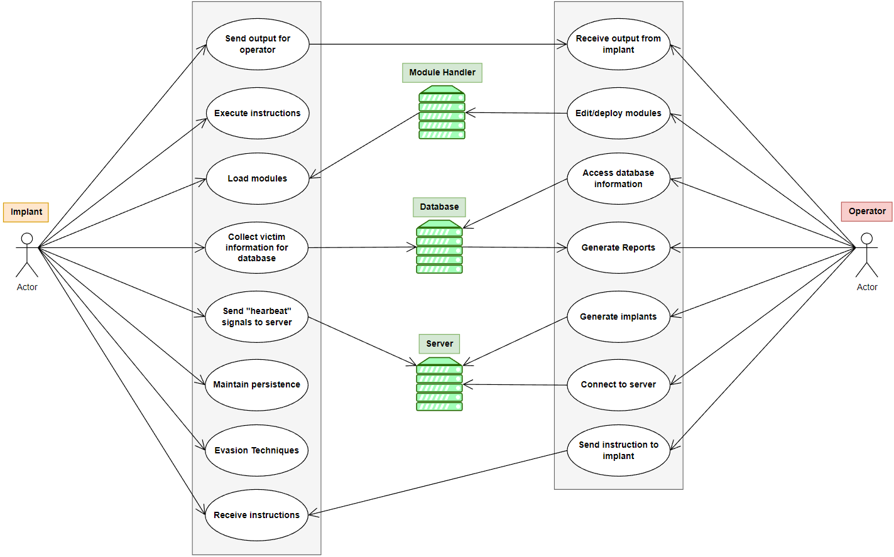
Use Case UML Diagram
G. Resto, K. Domenech, C. Roque Adversary Emulation Framework
15

Slide 17
References
Microsoft (2023, February). Dynamic Language Runtime Overview - .NET Framework. Microsoft Learn. https://learn.microsoft.com/en-us/dotnet/framework/reflection-and-codedom/dynamic-language-runtime-overview
Ali Awan, A. (2022, July). A Comprehensive Introduction to Graph Neural Networks (GNNs). https://www.datacamp.com/tutorial/comprehensive-introduction-graph-neural-networks-gnns-tutorial
G. Resto, K. Domenech, C. Roque Adversary Emulation Framework
16

Slide 18

Thank you

